Slide 1
Introduction to Computers and Programming (CS-111)

Slide 2
TEXT BOOKS and REFERENCES
Text Books:
E. Balaguruswamy, “Programming in ANSI C”, Tata McGraw Hill, 6th Edition.
E. Balaguruswamy, “Object Oriented Programming with C++”, Tata McGraw Hill, 5th Edition 2012.
References:
1. The Complete Reference – Fourth edition , Herbert Schildt
Object Orented Programming in C++ , Robert Lafore , 4 Edition.

Slide 3

Chapter - 1
Introduction to Computers

Slide 4
Objectives
To learn and appreciate the following concepts
Basic introduction, concepts
Functionality of a computer
Memory system and its types
Input – Output devices
Bus technology
Overview of Application Software
Overview of System Software
Overview of Operating Systems
Assemblers Compilers and Interpreters

Slide 5
Introduction to computers
A computer is an electronic device, operating under the control of instructions (Software) stored in its own memory unit.
It can accept data (Input), manipulate data (Process), and produce information (Output) from the processing.
Generally, the term “computer” is used to describe a collection of devices that function together as a system.
Notes:
Additional notes on Introduction to computers
Nowadays, computers are an integral part of our lives. They are used for the reservation of tickets for airplanes and railways, payment of telephone and electricity bills, deposit and withdrawal of money from banks, processing of business data, forecasting of weather conditions, diagnosis of diseases, searching for information on the Internet, etc. Computers are also used extensively in schools, universities, organizations, music industry, movie industry, scientific research, law firms, fashion industry, etc.
The term computer is derived from the word compute. The word compute means to calculate. A computer is an electronic machine that accepts data from the user, processes the data by performing calculations and operations on it, and generates the desired output results. Computer performs both simple and complex operations, with speed and accuracy.

Slide 6
Key characteristics of a computer
Speed → Faster processing
Accuracy → The quality or state of being correct or precise.
Diligence →persistent and determined effort to complete a task
Storage capability → Permanent storage & non-permanent
storage
Versatility → Having varied uses or serving many functions
Notes:
Additional notes on various characteristics of a computer
Speed: The computer can process data very fast, at the rate of millions of instructions per second. Some calculations that would have taken hours and days to complete otherwise, can be completed in a few seconds using the computer. For example, calculation and generation of salary slips of thousands of employees of an organization, weather forecasting that requires analysis of a large amount of data related to temperature, pressure and humidity of various places, etc.
Accuracy: Computer provides a high degree of accuracy. For example, the computer can accurately give the result of division of any two numbers up to 10 decimal places.
Diligence: When used for a longer period of time, the computer does not get tired or fatigued. It can perform long and complex calculations with the same speed and accuracy from the start till the end.
Storage Capability: Large volumes of data and information can be stored in the computer and also retrieved whenever required. A limited amount of data can be stored, temporarily, in the primary memory. Secondary storage devices like floppy disk and compact disk can store a large amount of data permanently.
Versatility: Computer is versatile in nature. It can perform different types of tasks with the same ease. At one moment you can use the computer to prepare a letter document and in the next moment you may play music or print a document.
Computers have several limitations too. Computer can only perform tasks that it has been programmed to do. Computer cannot do any work without instructions from the user. It executes instructions as specified by the user and does not take its own decisions.

Slide 7
Various Computing devices
Notes:
Additional notes on various computing devices
If you use a desktop computer, you might already know that there isn't any single part called the "computer." A computer is really a system of many parts working together. The physical parts, which you can see and touch, are collectively called hardware. (Software, on the other hand, refers to the instructions, or programs, that tell the hardware what to do.)
The system unit
The system unit is the core of a computer system. Usually it's a rectangular box placed on or underneath your desk. Inside this box are many electronic components that process information. The most important of these components is the central processing unit (CPU), or microprocessor, which acts as the "brain" of your computer. Another component is random access memory (RAM), which temporarily stores information that the CPU uses while the computer is on. The information stored in RAM is erased when the computer is turned off.
Almost every other part of your computer connects to the system unit using cables. The cables plug into specific ports (openings), typically on the back of the system unit. Hardware that is not part of the system unit is sometimes called a peripheral device or device.
Storage
Your computer has one or more disk drives—devices that store information on a metal or plastic disk. The disk preserves the information even when your computer is turned off.
Hard disk drive
Your computer's hard disk drive stores information on a hard disk, a rigid platter or stack of platters with a magnetic surface. Because hard disks can hold massive amounts of information, they usually serve as your computer's primary means of storage, holding almost all of your programs and files. The hard disk drive is normally located inside the system unit.
CD and DVD drives
Nearly all computers today come equipped with a CD or DVD drive, usually located on the front of the system unit. CD drives use lasers to read (retrieve) data from a CD, and many CD drives can also write (record) data onto CDs. If you have a recordable disk drive, you can store copies of your files on blank CDs. You can also use a CD drive to play music CDs on your computer.
Floppy disk drive
Floppy disk drives store information on floppy disks, also called floppies or diskettes. Compared to CDs and DVDs, floppy disks can store only a small amount of data. They also retrieve information more slowly and are more prone to damage. For these reasons, floppy disk drives are less popular than they used to be, although some computers still include them.
Mouse
A mouse is a small device used to point to and select items on your computer screen. Although mice come in many shapes, the typical mouse does look a bit like an actual mouse. It's small, oblong, and connected to the system unit by a long wire that resembles a tail. Some newer mice are wireless.
Keyboard
A keyboard is used mainly for typing text into your computer. Like the keyboard on a typewriter, it has keys for letters and numbers, but it also has special keys:
The function keys, found on the top row, perform different functions depending on where they are used.
The numeric keypad, located on the right side of most keyboards, allows you to enter numbers quickly.
The navigation keys, such as the arrow keys, allow you to move your position within a document or webpage.
Monitor
A monitor displays information in visual form, using text and graphics. The portion of the monitor that displays the information is called the screen. Like a television screen, a computer screen can show still or moving pictures.
There are two basic types of monitors: CRT (cathode ray tube) monitors and LCD (liquid crystal display) monitors. Both types produce sharp images, but LCD monitors have the advantage of being much thinner and lighter. CRT monitors, however, are generally more affordable.
Printer
A printer transfers data from a computer onto paper. You don't need a printer to use your computer, but having one allows you to print e‑mail, cards, invitations, announcements, and other materials. Many people also like being able to print their own photos at home.
The two main types of printers are inkjet printers and laser printers. Inkjet printers are the most popular printers for the home. They can print in black and white or in full color and can produce high-quality photographs when used with special paper. Laser printers are faster and generally better able to handle heavy use.
Speakers
Speakers are used to play sound. They may be built into the system unit or connected with cables. Speakers allow you to listen to music and hear sound effects from your computer.
Modem
To connect your computer to the Internet, you need a modem. A modem is a device that sends and receives computer information over a telephone line or high-speed cable. Modems are sometimes built into the system unit, but higher-speed modems are usually separate components.

Slide 8
What Does A Computer Do?
Computers can perform four general operations :
Input
Processing / Computation
Storage
Output
Notes:
Additional notes - what does a computer do?
A computer is a basic technology that is a better resource to other than books, radio, and etc...It also is more accurate on all topics and many different features.

Slide 9
Data and Information
Data – Collection of raw facts, figures and symbols.
Computers manipulate/processes data to create information.
Information is data that is organized, meaningful, and useful.
During the output Phase, the information that has been created is put into some form, such as a printed report.
Notes:
Additional notes on data and information
Data is raw, unorganized facts that need to be processed. Data can be something simple and seemingly random and useless until it is organized. When data is processed, organized, structured or presented in a given context so as to make it useful, it is called Information.

Slide 10
Instruction to computer
Program or software - a detailed list of instructions that tells the computer what exactly to do.
Before processing a specific job, the corresponding instructions (program) to do that job must be stored in memory.
Once the program is stored in memory the computer can start the operation by executing the program instructions one after the other.
Notes:
Additional notes on computer instructions
Basically a computer works with zeros and ones. A software program is created usually at a high level by a programmer and the subsequent code is converted into machine language (0 - 1) which is a language that the computer can understand and execute. When you select a button the button will access these programs which tell the computer: which circuits or switches to access -turn on or turn off, what system program to access - run or stop etc.

Slide 11
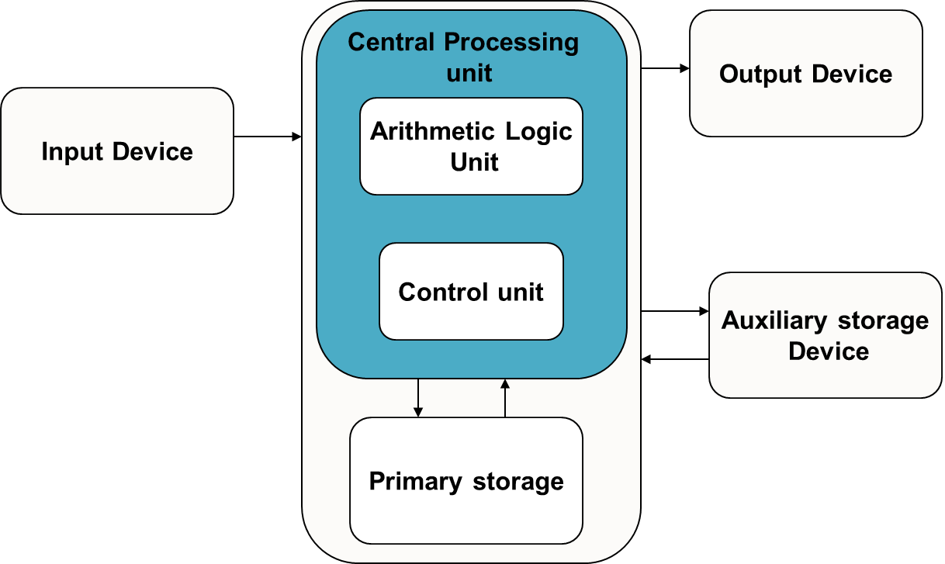
Block Diagram of a Computer
Notes:
Additional notes on computing process information
A computer can process data, pictures, sound and graphics. They can solve highly complicated problems quickly and accurately. There are basically five major computer operations or functions irrespective of their size and make. They are
1) It accepts data or instructions by way of input,
2) It stores data,
3) It can process data as required by the user,
4) It gives results in the form of output, and
5) It controls all operations inside a computer.
Computer operations
1. Input: This is the process of entering data and programs in to the computer system. You should know that computer is an electronic machine like any other machine which takes as inputs raw data and performs some processing giving out processed data. Therefore, the input unit takes data from us to the computer in an organized manner for processing.
2. Storage: The process of saving data and instructions permanently is known as storage. Data has to be fed into the system before the actual processing starts. It is because the processing speed of Central Processing Unit (CPU) is so fast that the data has to be provided to CPU with the same speed. Therefore the data is first stored in the storage unit for faster access and processing. This storage unit or the primary storage of the computer system is designed to do the above functionality. It provides space for storing data and instructions.
The storage unit performs the following major functions:
• All data and instructions are stored here before and after processing.
• Intermediate results of processing are also stored here.
3. Processing: The task of performing operations like arithmetic and logical operations is called processing. The Central Processing Unit (CPU) takes data and instructions from the storage unit and makes all sorts of calculations based on the instructions given and the type of data provided. It is then sent back to the storage unit.
4. Output: This is the process of producing results from the data for getting useful information. Similarly the output produced by the computer after processing must also be kept somewhere inside the computer before being given to you in human readable form. Again the output is also stored inside the computer for further processing.
5. Control: The manner how instructions are executed and the above operations are performed. Controlling of all operations like input, processing and output are performed by control unit. It takes care of step by step processing of all operations inside the computer.

Slide 12
Computer peripherals
Input, output, or auxiliary storage devices are attached to a computer
Input Devices include keyboard and mouse, scanners.
Output Devices include printers, video display, LCD screens.
Auxiliary Devices include disk drives, CD-ROM and DVD-ROM drives, modems, and digital cameras.
Notes:
Notes on computer peripherals
A peripheral is generally defined as any auxiliary device such as, for example, a computer mouse or keyboard, that connects to and works with the computer in some way. Other examples of peripherals are expansion cards, graphics cards, computers, image scanners, tape drives, microphones, loudspeakers, webcams and digital cameras. RAM – random access memory - straddles the line between peripheral and primary component; it is technically a storage peripheral, but is required for every major function of a modern computer and removing the RAM will effectively disable any modern machine. Many new devices such as smartphones and tablet computers have interfaces which allow them to be used as a peripheral by a full computer, though they are not host-dependent as other peripheral devices are. According to the most technical definition, the only pieces of a computer not considered to be peripherals are the CPU, power supply, motherboard and computer case.
Usually, the word peripheral is used to refer to a device external to the computer case, like a scanner, but the devices located inside the computer case are also technically peripherals. Devices that exist outside the computer case are called external peripherals, or auxiliary components. Examples: "Many of the external peripherals I own, such as my scanner and printer, connect to the peripheral ports on the back of my computer." Devices that are inside the case such as internal hard drives or CD-ROM drives are also peripherals in technical terms and are called internal peripherals, but may not be recognized as peripherals by laypeople.
In a system on a chip, peripherals are incorporated into the same integrated circuit as the CPU. They are still referred to as "peripherals" despite being permanently attached to (and in some sense part of) their host processor.

Slide 13
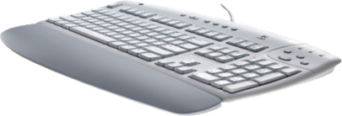
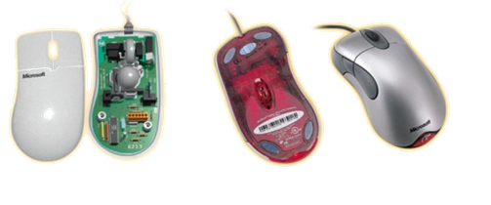
Input devices
An external device connected to the CPU, used to feed data and instructions for solving the problem at hand
Mouse
Keyboard
Joystick
Light pen
Trackball
Optical Scanner
Voice input
Notes:
Notes on Input devices
Input devices allow users and other applications to input data into the computer, for processing. The data input to a computer can be in the form of text, audio, video, etc.

Slide 14
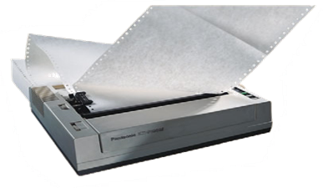
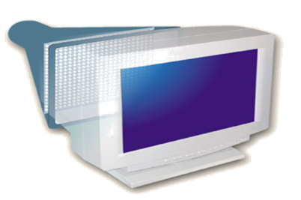
Output devices
An external device connected to the CPU that is used to display the results.
Monitor
printer
plotter
plasma display panels
LCD displays
voice output
Notes:
Notes on Output devices
Output devices provide output to the user, which is generated after processing the input data. The processed data, presented to the user via the output devices could be text, graphics, audio or video. The output could be on a paper or on a film in a tangible form, or, in an intangible form as audio, video and electronic form.

Slide 15
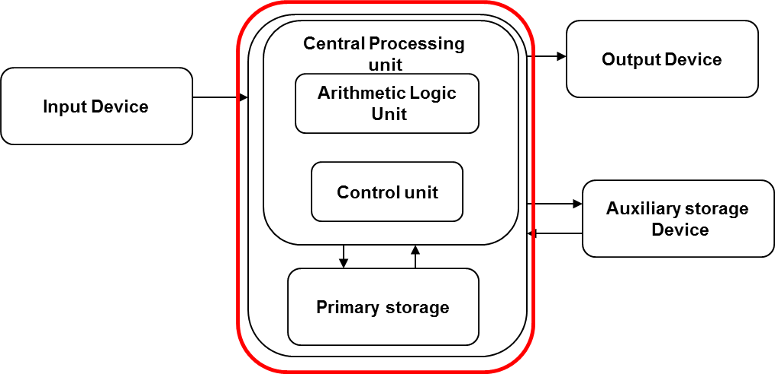
System unit
The Central Processing Unit and Memory Unit are together called as System Unit.
Data and instructions received from the input device are stored and processed in the System unit.
Notes:
Notes on functional units of a computer
In order to carry out the operations mentioned in the previous section the computer allocates the task between its various functional units. The computer system is divided into three separate units for its operation. They are
1) arithmetic logical unit
2) control unit.
3) central processing unit.

Slide 16
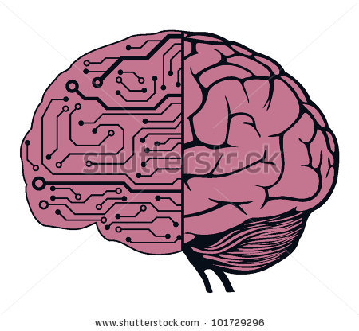
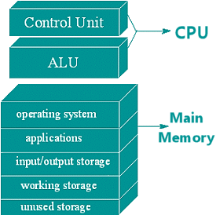
Central Processing Unit (CPU)
The data and instructions received from the input device are processed in this unit.
It is divided two functional units.
Control Unit (CU)
Arithmetic and Logic Unit (ALU)
Notes:
Additional notes on CPU
Central Processing Unit (CPU) or the processor is also often called the brain of computer. In addition, CPU also has a set of registers which are temporary storage areas for holding data, and instructions. ALU performs the arithmetic and logic operations on the data that is made available to it. CU is responsible for organizing the processing of data and instructions. CU controls and coordinates the activity of the other units of computer. CPU uses the registers to store the data, instructions during processing.

Slide 17
Arithmetic and Logical unit
Performs arithmetic and logical operations:
Example:
arithmetic(+,-,*,/ etc..) and
logical (AND, OR, NOT, <,= etc..) operations
Notes:
Additional notes on ALU
An eight bit instruction informs the ALU which operation it is to carry out. One number to be manipulated comes from the accumulator, the other from memory or another register. The result is stored in the accumulator. Flags in the status register are set to indicate the result, such as negative etc.

Slide 18
Control unit
Controls the order in which your program instructions are executed.
Functions of CU:
Fetches data and instructions to main memory
Interprets these instructions
Controls the transfer of data and instructions to and from main memory
Controls input and output devices.
Overall supervision of computer system
Notes:
Additional notes on CU
A control unit is circuitry that directs operations within the computer's processor by directing the input and output of a computer system. The processor then controls how the rest of the computer operates (giving directions to the other parts and systems). A control unit works by gathering input through a series of commands it receives from instructions in a running programs and then outputs those commands into control signals that the computer and other hardware attached to the computer carry out.
The control unit is basically circuitry inside the CPU, controlling the operations inside the CPU and "directing traffic" in a sense. The functions a control unit performs can depend on the type of CPU, since the varying degrees of architecture between all the different CPUs will determine the functions of the control unit.

Slide 19
Computer memory classifications
The computer memory is classified into:
Main memory / Primary storage memory
Eg. RAM, ROM
Secondary memory / Auxiliary storage memory
Eg. Magnetic tapes, magnetic disks,
Cache memory

Slide 20
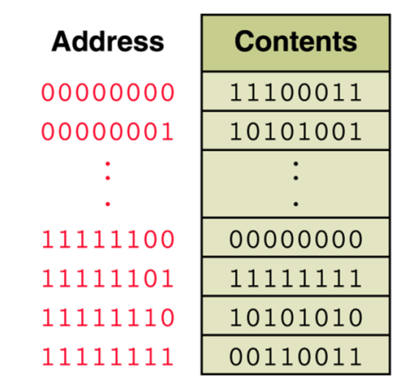
Memory unit
It is any storage device where the data and instructions fed by the user are stored.
It is an ordered sequence of storage cells, each capable of holding a piece of information
Each cell has its own unique address
Notes:
Additional notes on memory
The computer starts using the memory from the moment the computer is switched on, till the time it is switched off. The list of steps that the computer performs from the time it is switched on are—
1. Turn the computer on.
2. The computer loads data from ROM. It makes sure that all the major components of the computer are functioning properly.
The computer loads the BIOS from ROM. The BIOS provides the most basic information about storage devices, boot sequence, security, plug and play capability and other items.
3. The computer loads the OS from the hard drive into the system’s RAM. CPU has immediate access to the OS as the critical parts of the OS are maintained in RAM as long as the computer is on. This enhances the performance and functionality of the overall system.
4. Now the system is ready for use.
5. When you load or open an application it is loaded in the RAM. Since the CPU looks for information in the RAM, any data and instructions that are required for processing (read, write or update) is brought into RAM. To conserve RAM usage, many applications load only the essential parts of the program initially and then load other pieces as needed. Any files that are opened for use in that application are also loaded into RAM.
6. The CPU requests the data it needs from RAM, processes it and writes new data back to RAM in a continuous cycle. The shuffling of data between the CPU and RAM happens millions of times every second.
7. When you save a file and close the application, the file is written to the secondary memory as specified by you. The application and any accompanying files usually get deleted from RAM to make space for new data.
8. If the files are not saved to a storage device before being closed, they are lost.
The memory unit is the part of the computer that holds data and instructions for processing. Although it is closely associated with the CPU, in actual fact it is separate from it. Memory associated with the CPU is also called primary storage, primary memory, main storage, internal storage and main memory. When we load software from a floppy disk, hard disk or CD-ROM, it is stored in the memory unit.

Slide 21
Memory unit
The computer memory is measured in terms of bits, bytes and words.
A bit is a binary digit either 0 or 1.
A byte is unit of memory and is defined as sequence of 8 bits.
The word can be defined as a sequence of 16/32/64 bits or 2/4/8 bytes respectively depending on the machine architecture.
Notes:
Additional notes on memory units
The computer’s memory stores data, instructions required during the processing of data, and output results. Storage may be required for a limited period of time, instantly, or, for an extended period of time. Different types of memories, each having its own unique features, are available for use in a computer. The cache memory, registers, and RAM are fast memories and store the data and instructions temporarily during the processing of data and instructions. The secondary memories like magnetic disks and optical disks have large storage capacities and store the data and instructions permanently, but are slow memory devices. The memories are organized in the computer in a manner to achieve high levels of performance at the minimum cost.

Slide 22
Main memory / Primary memory
It is the place where the data and instructions of the program currently being executed are stored.
High speed.
This is a temporary memory because the data and instructions stored here get erased when the power goes off.
It is a semiconductor memory and measured in terms of megabytes and gigabytes.
Eg. RAM and ROM
Notes:
Additional notes associated with main memory
Primary memory is the main memory of computer.
It is a chip mounted on the motherboard of computer.
Primary memory is categorized into two main types- Random Access Memory (RAM), and Read Only Memory (ROM).

Slide 23
RAM & ROM
RAM stands for Random Access Memory
It is the read and write memory.
Any memory location can be accessed directly without
accessing it sequentially.
Hence it is called as random access memory.
During power failure the information stored in it will be
erased.
It is also called as volatile memory.
ROM stands for Read Only Memory
It is a permanent memory and non-volatile.
The contents in ROM can not be changed
It stores mainly stored program and basic input output
systems programs.

Slide 24
Classifications of ROM
PROM :Programmable Read Only Memory
It is a variation of ROM.
The contents of this memory are decided by the user
These contents can not be erased once they are written to it.
EPROM : Erasable Programmable Read Only Memory
It is a modification to PROM.
Contents stored can be erased by exposing it to Ultra Violet Light source.
EEPROM: Electrically Erasable Programmable Read Only Memory
The contents stored in this can be erased electrically.
[ Flash, micro processors etc.]

Slide 25
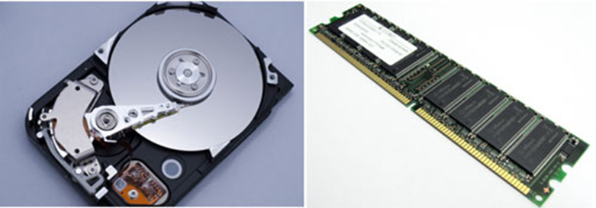
Secondary Storage Devices
It is made up of magnetic material and stores large amount of information for long time.
Low speed.
Non volatile memory
Holds programs not currently being executed.
Eg. Magnetic tapes, magnetic disks, compact disks etc.

Slide 26
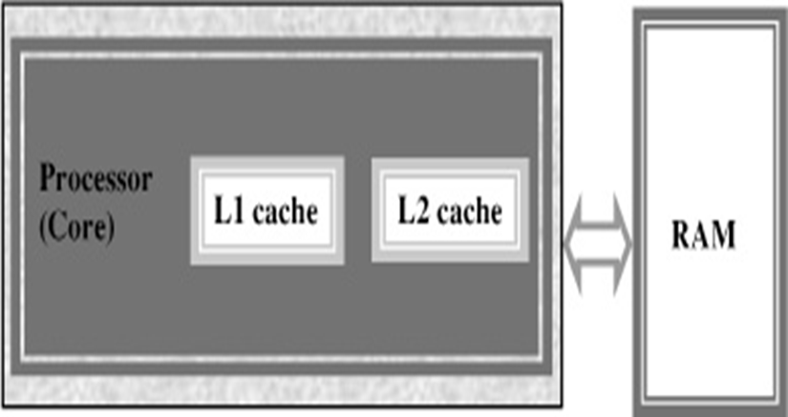
Cache memory
It is a High speed memory and placed between the CPU and the main memory.
Users can not access this memory.
It stores the data and instructions currently to be executed.
More costlier but less capacity than main memory.
Notes:
Additional notes on cache memory
The data and instructions that are required during the processing of data are brought from the secondary storage devices and stored in the RAM. For processing, it is required that the data and instructions are accessed from the RAM and stored in the registers. The time taken to move the data between RAM and CPU registers is large. This affects the speed of processing of computer, and results in decreasing the performance of CPU.
Cache memory is a very high speed memory placed in between RAM and CPU. Cache memory increases the speed of processing.
Cache memory is a storage buffer that stores the data that is used more often, temporarily, and makes them available to CPU at a fast rate. During processing, CPU first checks cache for the required data. If data is not found in cache, then it looks in the RAM for data.
To access the cache memory, CPU does not have to use the motherboard’s system bus for data transfer. (The data transfer speed slows to the motherboard’s capability, when data is passed through system bus. CPU can process data at a much faster rate by avoiding the system bus.)
Cache memory is built into the processor, and may also be located next to it on a separate chip between the CPU and RAM. Cache built into the CPU is faster than separate cache, running at the speed of the microprocessor itself. However, separate cache is roughly twice as fast as RAM.
The CPU has a built-in Level 1 (L1) cache and Level 2 (L2) cache. In addition to the built-in L1 and L2 cache, some CPUs have a separate cache chip on the motherboard. This cache on the motherboard is called Level 3 (L3) cache. Nowadays, high-end processor comes with built-in L3 cache, like in Intel core i7. The L1, L2 and L3 cache store the most recently run instructions, the next ones and the possible ones, respectively. Typically, CPUs have cache size varying from 256KB (L1), 6 MB (L2), to 12MB (L3) cache.

Slide 27
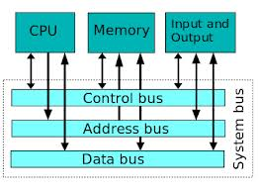
Computer BUS
Computer components are connected by a bus.
A bus is a group of parallel wires that carry control signals and data between components
Notes:
Additional notes on BUS
A bus, in computing, is a set of physical connections (cables, printed circuits, etc.) which can be shared by multiple hardware components in order to communicate with one another.
Characteristics of a bus
A bus is characterized by the amount of information that can be transmitted at once. This amount, expressed in bits, corresponds to the number of physical lines over which data is sent simultaneously. A 32-wire ribbon cable can transmit 32 bits in parallel. The term "width" is used to refer to the number of bits that a bus can transmit at once.
Additionally, the bus speed is also defined by its frequency (expressed in Hertz), the number of data packets sent or received per second. Each time that data is sent or received is called a cycle.
This way, it is possible to find the maximum transfer speed of the bus, the amount of data which it can transport per unit of time, by multiplying its width by its frequency.

Slide 28
Classifications of software
Software
Application Software
System Software
Notes:
Additional notes
Modern computers are complex instruments involving many different parts. To keep it running well you will need system software. System software will handle the smooth running of all the components of the computer as well as providing general functionality for other programs to use, tools to speed up the computer, tools to develop new software and programs to keep you safe from attacks. There are several different types of system software that we will look at in more detail very shortly:
Operating Systems are a collection of programs that make the computer hardware conveniently available to the user and also hide the complexities of the computer's operation. The Operating System (such as Windows 7 or Linux) interprets commands issued by application software (e.g. word processor and spreadsheets). The Operating System is also an interface between the application software and computer. Without the operating system, the application programs would be unable to communicate with the computer.
Utility programs are small, powerful programs with a limited capability, they are usually operated by the user to maintain a smooth running of the computer system. Various examples include file management, diagnosing problems and finding out information about the computer etc. Notable examples of utility programs include copy, paste, delete, file searching, disk defragmenter, disk cleanup. However, there are also other types that can be separately installable from the Operating System.
Library programs are a compiled collection of subroutines
Translator software (Compiler, Assembler, Interpreter)
Application software
Application software is designed for people like me and you to perform tasks that we consider useful. This might be the ability of a scientist to work out statistical information using a set of results, or someone who wants to play the latest computer game. There are several categories of Application software that we'll look into shortly:
General purpose application software.
Special purpose application software.
Bespoke application software

Slide 29
System software
System software consists of programs that manages the computer resources.
Divided into three classes
Operating System
Utility software
System Development software
Notes:
Additional notes on System Software
System software is a program that manages and supports the computer resources and operations of a computer system while it executes various tasks such as processing data and information, controlling hardware components, and allowing users to use application software. That is, systems software functions as a bridge between computer system hardware and the application software. System software is made up of many control programs, including the operating system, communications software and database manager. There are many kinds of computers these days. Some of them are easier to learn than others. Some of them perform better than others. These differences may come from different systems software. Three Kinds of Programs
Systems software consists of three kinds of programs. The system management programs, system support programs, and system development programs are they. These are explained briefly.
System Management Programs
These are programs that manage the application software, computer hardware, and data resources of the computer system. These programs include operating systems, operating environment programs, database management programs, and telecommunications monitor programs. Among these, the most important system management programs are operating systems. The operating systems are needed to study more details. There are two reasons. First, users need to know their functions first. For the second, there are many kinds of operating systems available today.
Telecommunications monitor programs are additions of the operating systems of microcomputers. These programs provide the extra logic for the computer system to control a class of communications devices.
System Support Programs
These are the programs that help the operations and management of a computer system. They provide a variety of support services to let the computer hardware and other system programs run efficiently. The major system support programs are system utility programs, system performance monitor programs, and system security monitor programs (virus checking programs).
System Development Programs
These are programs that help users develop information system programs and prepare user programs for computer processing. These programs may analyze and design systems and program itself. The main system development programs are programming language translators, programming environment programs, computer-aided software engineering packages.

Slide 30
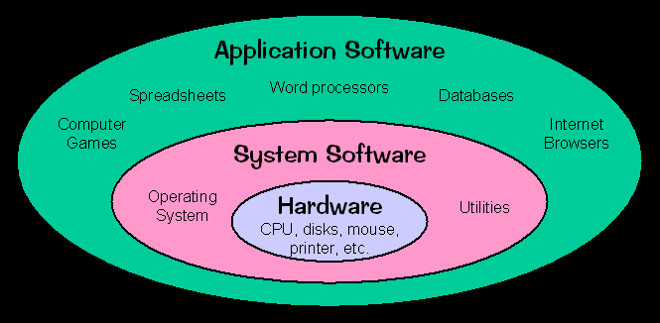
Notes:
Additional notes on System Software
System software is a program that manages and supports the computer resources and operations of a computer system while it executes various tasks such as processing data and information, controlling hardware components, and allowing users to use application software. That is, systems software functions as a bridge between computer system hardware and the application software. System software is made up of many control programs, including the operating system, communications software and database manager. There are many kinds of computers these days. Some of them are easier to learn than others. Some of them perform better than others. These differences may come from different systems software. Three Kinds of Programs
Systems software consists of three kinds of programs. The system management programs, system support programs, and system development programs are they. These are explained briefly.
System Management Programs
These are programs that manage the application software, computer hardware, and data resources of the computer system. These programs include operating systems, operating environment programs, database management programs, and telecommunications monitor programs. Among these, the most important system management programs are operating systems. The operating systems are needed to study more details. There are two reasons. First, users need to know their functions first. For the second, there are many kinds of operating systems available today.
Telecommunications monitor programs are additions of the operating systems of microcomputers. These programs provide the extra logic for the computer system to control a class of communications devices.
System Support Programs
These are the programs that help the operations and management of a computer system. They provide a variety of support services to let the computer hardware and other system programs run efficiently. The major system support programs are system utility programs, system performance monitor programs, and system security monitor programs (virus checking programs).
System Development Programs
These are programs that help users develop information system programs and prepare user programs for computer processing. These programs may analyze and design systems and program itself. The main system development programs are programming language translators, programming environment programs, computer-aided software engineering packages.

Slide 31
Operating system
Operating System is an integrated collection of programs which make the computer operational and help in executing user programs.
It acts as interface between the man and machine.
It manages the system resources like memory, processors, input-output devices and files.
Types:
Single user [DOS] and Multi user OS [Windows XP, Unix],
Real time OS [Windows CE, QNX],
Single-tasking [DOS] and Multi-tasking [Unix],
Distributed OS [Amoeba],
Embedded OS [Windows CE, Symbian OS] etc.
Notes:
Additional notes on Operating Systems
An operating system is a collection of integrated computer programs that provide recurring services to other programs or to the user of a computer. These services consist of disk and file management, memory management, and device management. In other words, it manages CPU operations, input/output activities, storage resources, diverse support services, and controls various devices. Operating system is the most important program for computer system. Without an operating system, every computer program would have to contain instructions telling the hardware each step the hardware should take to do its job, such as storing a file on a disk. Because the operating system contains these instructions, any program can call on the operating system when a service is needed.
Need to Study Operating System?
There are many different computer systems and several available operating systems. Thus, users must know what each operating system can do and cannot do to meet their necessity. Today, many operating systems are used for general use or sometimes for specific use. Then, which one is best for a specific purpose? The reason that users need to study operating system is here. The predominant microcomputer operating system for IBM and IBM-compatibles so far was DOS (Disk Operating System). It has different versions including MS-DOS, PC-DOS and others. DOS is very popular and wide spread, but it has some limitations. Users need to learn DOS although it may fade out in a few years and has some weakness, because it will be used for the next several years. The other popular operating system was the Apple Macintosh operating system. As more powerful microcomputers become commonplace, more advanced operating systems are needed. Microcomputer users are beginning to demand more powerful operating system that can run powerful microcomputers more efficiently. Today's very powerful microcomputers are demanding more complex and refined operating system that can do multifunctions. They also ask an easier user interface than old operating systems did. Now, there are more than six popular operating systems, leading to the lack of a standard. The other reason that operating system should be learned is here.
Additional information on - How OS uses memory
Here explains in case of DOS. When a personal computer is turned on, it searches specific locations on the disk drives for operating system files. If the PC finds the files, it loads the first of them into memory. A set of operating system files then takes over, loading the rest of the main files into memory in a specific order. Because the operating system is in a sense, loading itself or lifting itself by its own bootstraps, this operation is called the boot-up. At the lowest part of memory, the operating system loads a table of interrupt vectors. When the operating system receives special codes called interrupts, it uses the table to detect where in memory it can find matching instructions. DOS also uses a small area just above the interruption table to hold the BIOS data called 'flags' that record the state of various system conditions. The same area also acts as a buffer to store keystrokes that come in faster than the system can process them. A large expanse of memory just above the BIOS flags and keyboard buffer is used for device drivers, utility programs, and application programs. When DOS reads the CONFIG.SYS and AUTOEXEC.BAT files, it looks for command lines to load drivers or memory-resident programs. Memory- resident programs are those that continue to be active even when application programs are running. When it finds such a command line, DOS normally puts the driver or program at the start of this large memory area. Device drivers usually remain loaded until the PC is turned off. Memory- resident programs can be unloaded if no other programs are loaded after them.
Operating System Functions
An operating system executes many functions to operate computer system efficiently. Among them, four essential functions are the followings.
Resource Management: An operating system manages a collection of computer hardware resources by using a variety of programs. It manages computer system resources, including its CPU, primary memory, virtual memory, secondary storage devices, input/output peripherals, and other devices.
Task Management:
The function of the operating system is to control the running of many tasks. It manages one program or many programs within a computer system simultaneously. That is, this function of operating system manages the completion of users' tasks. A task management program in an operating system provides each task and interrupts the CPU operations to manage tasks efficiently. Task management may involve a multitasking capability.
File management: This is a function that manages data files. An operating system contains file management programs that provide the ability to create, delete, enter, change, ask, and access of files of data. They also produce reports on a file.
User Interface: It is a function of an operating system that allows users to interact with a computer. A user interface program may include a combination of menus, screen design, keyboard commands. A well-designed user interface is essential for an operating system to be popular. Because of the function, users can load programs, access files, and accomplish other tasks.

Slide 32
An operating system is..
A program that runs on the “raw” hardware and supports resource sharing
Operating System hides the messy details which must be performed from the users
Manages the hardware resources
Each program gets time with the resource
Each program gets space on the resource
Manages different goals:
Use hardware efficiently and give maximum performance to each user.

Slide 33
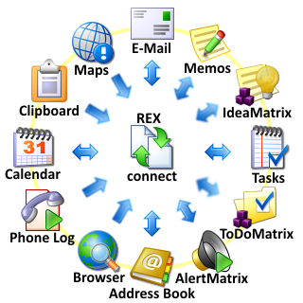
Application software
Application Software is directly responsible for helping users solve their problems.
For example
Word processing
Electronic spreadsheet
Database
Presentation graphics
Notes:
Additional notes on Application software
Application software applies the power of a particular computing platform or system software to a particular purpose.
Some applications are available in versions for several different platforms; others have narrower requirements and are thus called, for example, a geography application for windows or an android application for education or linux gaming. Sometimes a new and popular application arises which only runs on one platform, increasing the desirability of that platform. This is called a killer application.

Slide 34
Computer Languages
Machine Language- The only programming language available in earlier days
Consists of only 0’s and 1’s; e.g.:- 10101011
Symbolic language or Assembly language-
symbols or mnemonics used to represent instructions
e.g. ADD X,Y; Add the contents of y to x
High-level languages- English like language using which the programmer can write programs to solve a problem.
e.g.: C, C++, C#, Fortran, BASIC, Pascal etc.
Notes:
Additional notes on computer languages
Machine Level Language
Computer works in bits and bytes. It understands the language of the binary digits, 0 and 1. You may write a program in whichever language you want, but it is finally converted into the language of 0s and 1s before it gets executed. Writing a program in machine language is definitely very difficult. It is not possible to memorize a long string of 0s and 1s for every instruction that you want to derive executed. It is proper that before the higher levels of programming languages were designed, machine languages were old-fashioned for writing programming codes, but they are no longer traditional for designing computer programs.
Assembly Level Language
An assembly level language is unprejudiced one level above the shameful level machine languages. No doubt, designing a program in assembly language is also not a very simple task, but smooth the programming code is quite understandable. A person with a apt hand in assembly level language can very easily understand the statements. Till date, many of the programs for embedded technology are designed in assembly language. A computer program like the assembler is broken-down for converting the assembly level programs into their corresponding machine level programs.
High Level Language
High level languages are far more simpler to understand for the humans, than the assembly level language or machine level language. There are determined statements for writing, each and every instruction. However, whatever language you learn, you need to have a fine conception of the basics of that computer language. Without luminous the basics of a particular language, you cannot write a program in that language. The languages in these categories have different purposes. Some are meant for web programming, some are meant to produce simple desktop applications, while some can do both. But, one thing that you need to understand is that, high level language is not at all understandable for the computer. For the purpose of notion a computer program written in a high level language, it uses a compiler or interpreter to convert the programming code into its equivalent machine language build. The high level languages can also be broadly classified into two types; intention oriented languages and object oriented languages. Let me try to elaborate to you, these two types of programming languages in brief.
In the contrivance oriented languages, the instructions are executed one by one and the process is given more importance. There is one main function or process that includes all the other functions. Every time a current location of data is created, the functions need to be redesigned. The BASIC programming language and C language are the two most popular examples of high level language.
In the object oriented programming language, the main emphasis is given to the data. The process of programming becomes simpler as the code remains re-usable, under all cases. Even if the data changes, there is no impact on the remaining code. Java and C++ are the most commonly worn OOP languages.
Besides, these three basic types of languages, there is a next generation of programming language being developed, which is referred to as the fourth generation language. Fourth generation language are being designed with the perspective, that a person with limited or no programming experience can also exercise these languages to prepare his maintain code. No doubt, even the high level languages like Java, have incorporated such systems, so that the person writing the programming code does not have to memorize each and every function.

Slide 35
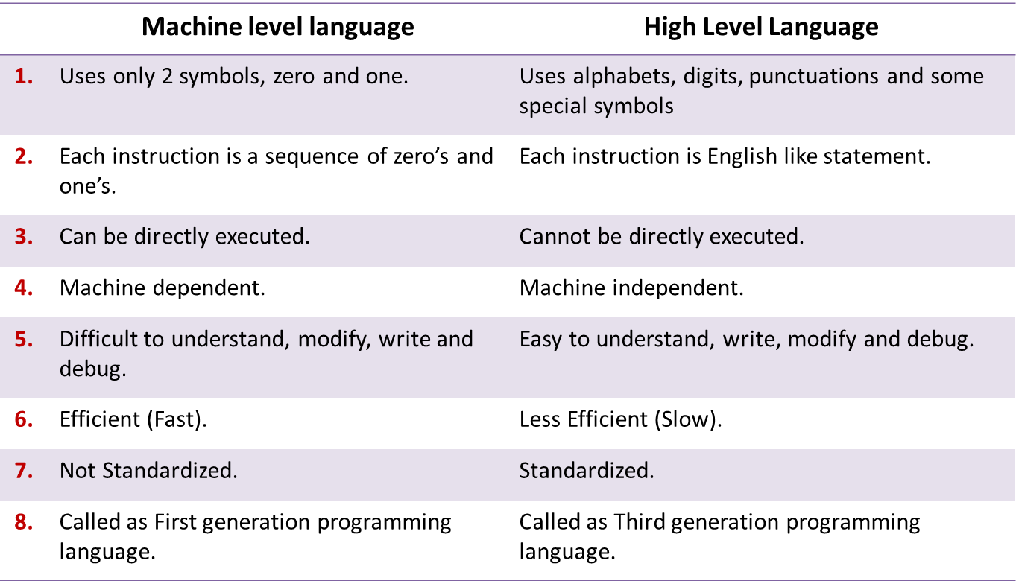
Machine level vs High level languages

Slide 36
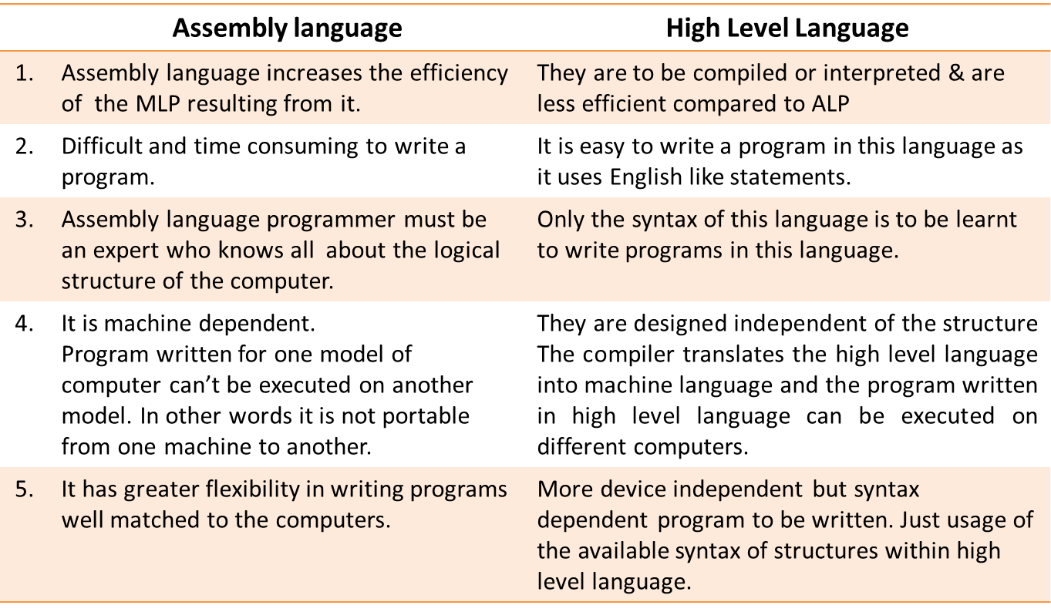
Assembly language Vs High level language

Slide 37
Language Translators
Compiler : It translates a high-level language program into machine language program at a time.
e.g.:- C, C++ compilers.
Interpreter : It translates one statement of a high-level language program into machine language at a time and executes it.
e.g.:- Basic Interpreters, Java Interpreters.
Assembler : is a program which translates an assembly language program into machine language.
e.g.:- TASM(Turbo ASseMbler), MASM.
Notes:
Related story
Assembler
An assembler translates assembly language into machine code. Assembly language consists of mnemonics for machine opcodes so assemblers perform a 1:1 translation from mnemonic to a direct instruction.
For example: LDA #4 converts to 0001001000100100
Conversely, one instruction in a high level language will translate to one or more instructions at machine level.
Advantages of using an Assembler:
Very fast in translating assembly language to machine code as 1 to 1 relationship
Assembly code is often very efficient (and therefore fast) because it is a low level language
Assembly code is fairly easy to understand due to the use of English-like mnemonics
Disadvantages of using Assembler:
Assembly language is written for a certain instruction set and/or processor
Assembly tends to be optimized for the hardware it's designed for, meaning it is often incompatible with different hardware
Lots of assembly code is needed to do relatively simple tasks, and complex programs require lots of programming time
Compiler
A Compiler is a computer program that translates code written in a high level language to a lower level language, object/machine code. The most common reason for translating source code is to create an executable program (converting from a high level language into machine language).
Advantages of using a compiler
Source code is not included; therefore compiled code is more secure than interpreted code
Tends to produce faster code than interpreting source code
Produces an executable file, and therefore the program can be run without need of the source code
Disadvantages of using a compiler
Object code needs to be produced before a final executable file, this can be a slow process
The source code must be 100% correct for the executable file to be produced
Interpreter
An interpreter program executes other programs directly, running through program code and executing it line-by-line. As it analyses every line, an interpreter is slower than running compiled code but it can take less time to interpret program code than to compile and then run it — this is very useful when prototyping and testing code. Interpreters are written for multiple platforms, this means code written once can be run immediately on different systems without having to recompile for each. Examples of this include flash based web programs that will run on your PC, MAC, games console and Mobile phone.
Advantages of using an Interpreter
Easier to debug (check errors) than a compiler
Easier to create multi-platform code, as each different platform would have an interpreter to run the same code
Useful for prototyping software and testing basic program logic
Disadvantages of using an Interpreter
Source code is required for the program to be executed, and this source code can be read making it insecure
Interpreters are generally slower than compiled programs due to the per-line translation method

Slide 38
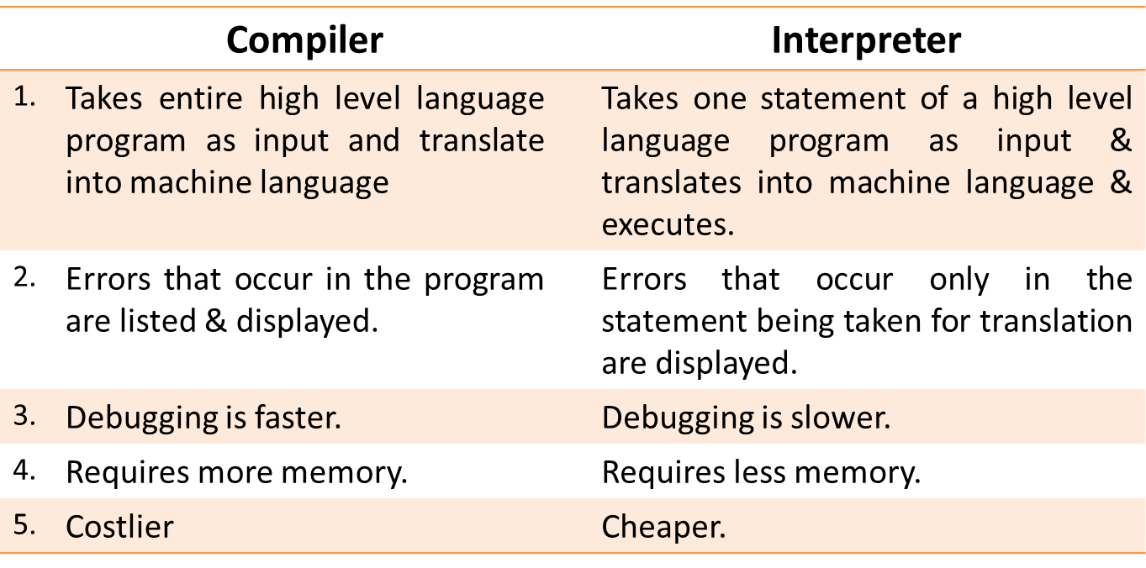
Compiler Vs Interpreter
Notes:
Additional notes (Compiler Vs. Interpreter)
If the translator translates a high level language into another high level language, it's called a source-to-source compiler, transcompiler, or transpiler. Examples include Haxe, FORTRAN-to Ada translators, CHILL-to-C++ translators, PASCAL-to C translators, COBOL(DialectA)-to-COBOL(DialectB) translators.
If the translator translates a high level language into a lower level language it is called a compiler.
If the translator translates a high level language into an intermediate code which will be immediately executed it is called an interpreter.
If the translator translates target/machine code to source language it is called a decompiler.
Example: DCC, Boomerang Decompilers and Reverse Engineering Compiler (REC).
If the translator translates assembly language to machine code it is called an assembler. Examples include MASM, TASM, NASM and FASM.
If the translator translates machine code into assembly language it is called a disassembler. Examples include gdb, IDA Pro and OllyDbg.

Slide 39
Summary
Introduction to Computers
Block Diagram of Computer
Computer Memory Classification
Software classifications
Overview of Application Software
Overview of System Software
Overview of Operating Systems
Functionality of Assemblers Compilers and Interpreters

